Slide 1
Book1
File created on: 22-08-2020 16:48:32

Slide 2
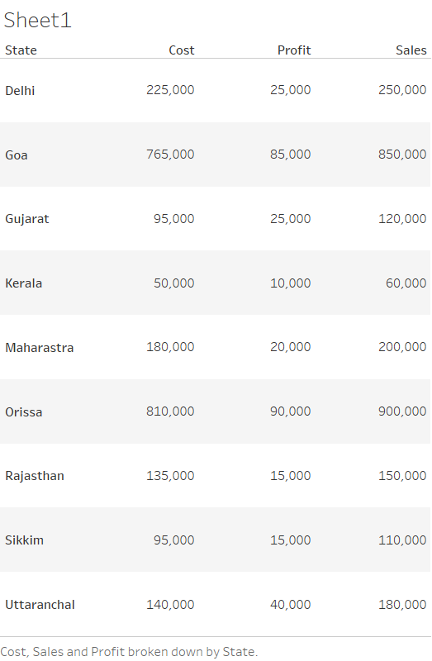

Slide 3
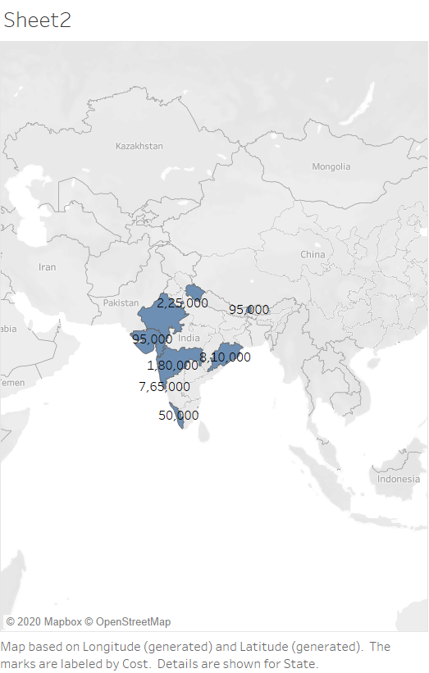

Slide 4
